Slide 1
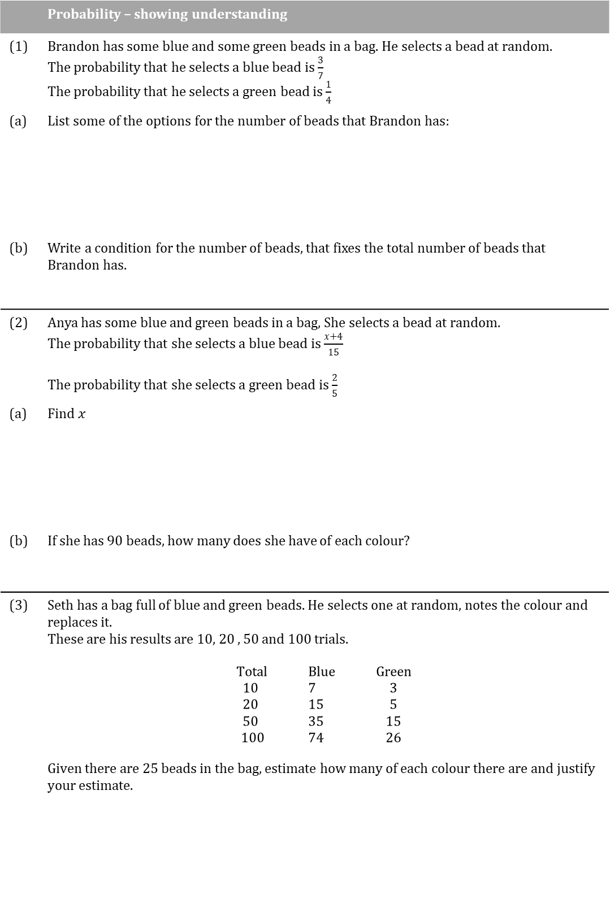
 | Probability – showing understanding
(1) | Brandon has some blue and some green beads in a bag. He selects a bead at random. The probability that he selects a blue bead is $\frac{3}{7}$ The probability that he selects a green bead is $\frac{1}{4}$
(a) | List some of the options for the number of beads that Brandon has:
(b) | Write a condition for the number of beads, that fixes the total number of beads that Brandon has.
(2) | Anya has some blue and green beads in a bag, She selects a bead at random. The probability that she selects a blue bead is $\frac{x+4}{15}$ The probability that she selects a green bead is $\frac{2}{5}$
(a) | Find $x$
(b) | If she has 90 beads, how many does she have of each colour?
(3) | Seth has a bag full of blue and green beads. He selects one at random, notes the colour and replaces it. These are his results are 10, 20 , 50 and 100 trials. $$\begin{aligned}\text{Total} &\text{Blue} &\text{Green} \\ 10 &7&3 \\ 20 &15&5 \\ 50 &35&15 \\ 100 &74&26\end{aligned}$$ Given there are 25 beads in the bag, estimate how many of each colour there are and justify your estimate.

Slide 2
 | Probability – showing understanding
(4) | Farhan and Oliver are playing a game with two five sided spinners. Farhan spins the two spinners, finds the difference between the two numbers and squares this to find his score
(a) | Calculate the probability that his score is greater than 4
 | Oliver spins the spinners and adds the two values together.
(b) | Calculate the probability that Oliver’s score is greater than or equal 4.
 | The winner is the person with the greater score
(c) | Calculate P(Farhan wins) P(Oliver wins) P(The game is drawn)

Slide 3
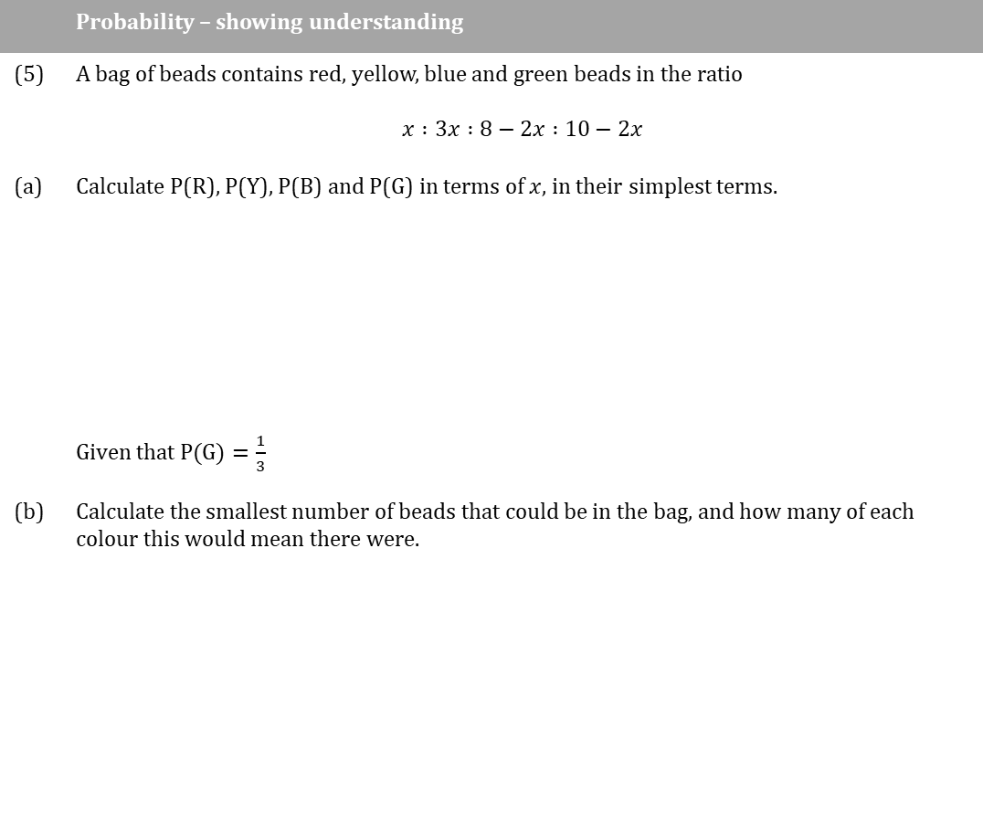
 | Probability – showing understanding
(5) | A bag of beads contains red, yellow, blue and green beads in the ratio $$x :3x :8−2x :10−2x$$
(a) | Calculate P(R), P(Y), P(B) and P(G) in terms of $x$, in their simplest terms.
 | Given that $\text{P}\text{(}\text{G}\text{)}=\frac{1}{3}$
(b) | Calculate the smallest number of beads that could be in the bag, and how many of each colour this would mean there were.

